Slide 1
Data Mining
Lecture 5

Slide 2
The importance of Statistics
Why we need to use descriptive summaries?
  Motivation
    To better understand the data: central tendency, variation and spread
  Data dispersion characteristics
    median, max, min, quantiles, outliers, variance, etc.
  Numerical dimensions correspond to sorted intervals
    Data dispersion: analyzed with multiple granularities of precision
    Boxplot or quantile analysis on sorted intervals
  Dispersion analysis on computed measures
    Folding measures into numerical dimensions
    Boxplot or quantile analysis on the transformed cube

Slide 3
Remember Stats Facts
Min:
  What is the big oh value for finding min of n-sized list ?
Max:
  What is the min number of comparisons needed to find the max of n-sized list?
Range:
  Max-Min
  What about simultaneous finding of min-max?
Value Types:
  Cardinal value -> how many, counting numbers
  Nominal value -> names and identifies something
  Ordinal value -> order of things, rank, position
  Continuous value -> real number

Slide 4
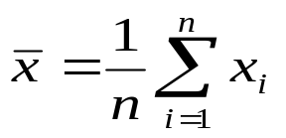

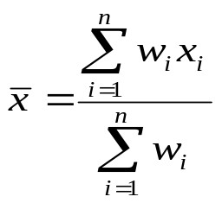
Remember Stats Facts
Mean (algebraic measure) (sample vs. population):
  Weighted arithmetic mean:
  Trimmed mean: chopping extreme values
Median: A holistic measure
  Middle value if odd number of values, or average of the middle two values otherwise
  Estimated by interpolation (for grouped data):
Mode
  Value that occurs most frequently in the data
  Unimodal, bimodal, trimodal
  Empirical formula:

Slide 5





Transformation
Min-max normalization: to [new_minA, new_maxA]
  Ex. Let income range $12,000 to $98,000 normalized to [0.0, 1.0]. Then $73,600 is mapped to
Z-score normalization (μ: mean, σ: standard deviation):
Ex. Let μ = 54,000, σ = 16,000. Then
Normalization by decimal scaling
Where j is the smallest integer such that Max(|ν’|) < 1
Notes:
Z-score = Standart score
The standard score indicates how many standard deviations an observation is above or below the mean.
NORMALISATION
In one usage in statistics, normalization is the process of removing statistical error in repeated measured data. A normalization is sometimes based on a property. Quantile normalization, for instance, is normalization based on the magnitude of the measures.

Slide 6



The importance of Mean and Median: figuring out the shape of the distribution
symmetric
mean > median > mode
mean < median < mode
positively skewed
negatively skewed

Slide 7
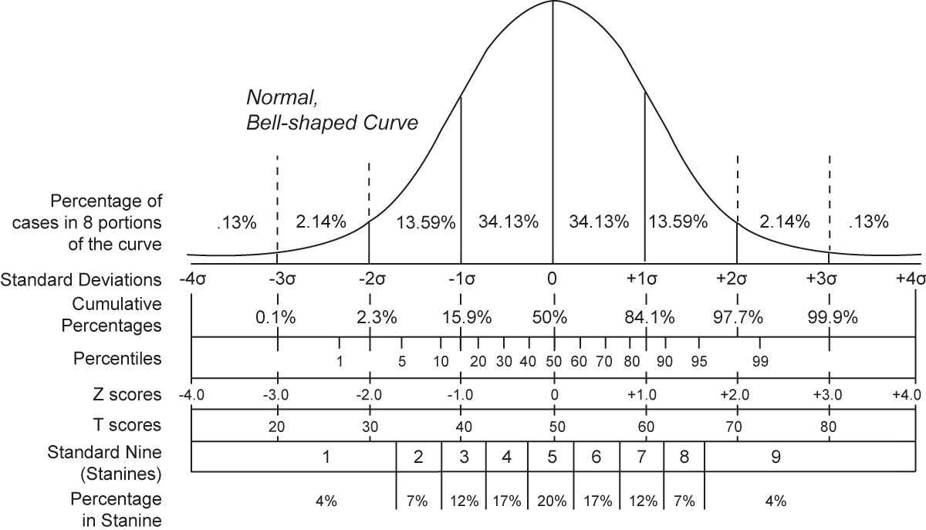

Slide 8
Measuring dispersion of data
Quantiles:
Quantiles are points taken at regular intervals from the cumulative distribution function (CDF) of a random variable. Dividing ordered data into q essentially equal-sized data subsets is the motivation for q-quantiles; the quantiles are the data values marking the boundaries between consecutive subsets
The 1000-quantiles are called permillages --> Pr
The 100-quantiles are called percentiles --> P
The 20-quantiles are called vigiciles --> V
The 12-quantiles are called duo-deciles --> Dd
The 10-quantiles are called deciles --> D
The 9-quantiles are called noniles (common in educational testing)--> NO
The 5-quantiles are called quintiles --> QU
The 4-quantiles are called quartiles --> Q
The 3-quantiles are called tertiles or terciles --> T

Slide 9



Measuring dispersion of data
k th standardized moment
The first standardized moment is zero,
because the first moment about the mean is zero
The second standardized moment is one,
because the second moment about the mean is equal to the variance
(the square of the standard deviation)
The third standardized moment is the skewness (seen before)
The fourth standardized moment is the kurtosis (estimate peak structure)

Slide 10


Measuring dispersion of data
Quartiles, outliers and boxplots
  Quartiles: Q1 (25th percentile), Q3 (75th percentile)
  Inter-quartile range: IQR = Q3 – Q1
  Five number summary: min, Q1, MEDIAN, Q3, max
  Boxplot: ends of the box are the quartiles, median is marked, whiskers, and plot outlier individually
  Outlier: usually, a value higher/lower than 1.5 x IQR
Variance and standard deviation (sample: s, population: σ)
  Variance: (algebraic, scalable computation)
  Standard deviation s (or σ) is the square root of variance s2 (or σ2)

Slide 11
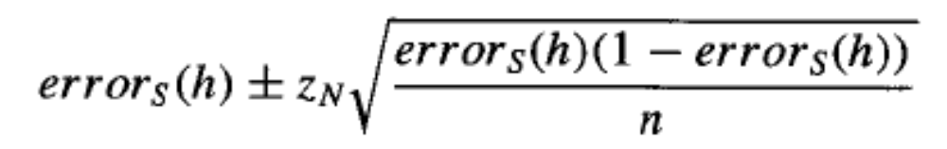

Measuring dispersion of data
the sample error of a hypothesis with respect to some sample S of instances
drawn from X is the fraction of S that it misclassifies
the true error of a hypothesis is the probability that it will misclassify a
single randomly drawn instance from the distribution D
Estimation bias (difference between true error and sample error)

Slide 12



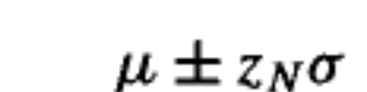
Measuring dispersion of data

Slide 13
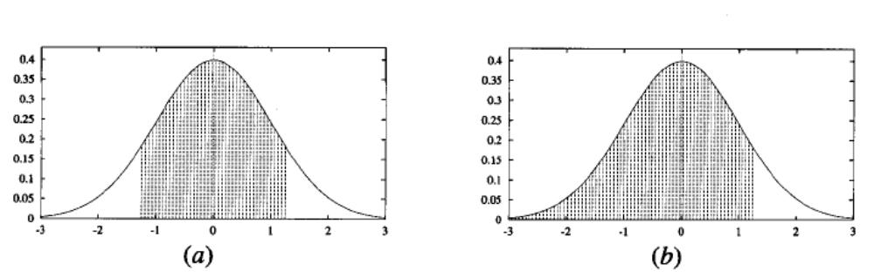
Measuring dispersion of data

Slide 14


Measuring dispersion of data
Chebiyshev Inequality
Let X be a random variable with expected value μ and
finite variance σ². Then for any real number k > 0,
Only the cases k > 1 provide useful information.
This can be equivalently stated as
  At least 50% of the values are within √2 standard deviations from the mean.
  At least 75% of the values are within 2 standard deviations from the mean.
  At least 89% of the values are within 3 standard deviations from the mean.
  At least 94% of the values are within 4 standard deviations from the mean.
  At least 96% of the values are within 5 standard deviations from the mean.
  At least 97% of the values are within 6 standard deviations from the mean.
  At least 98% of the values are within 7 standard deviations from the mean.

Slide 15
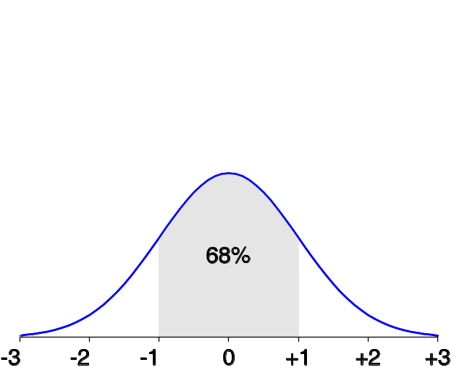
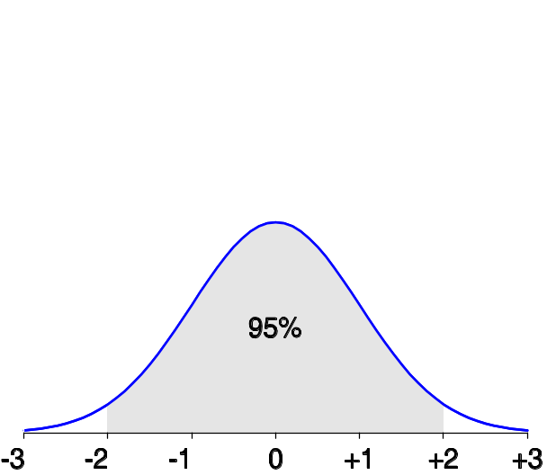
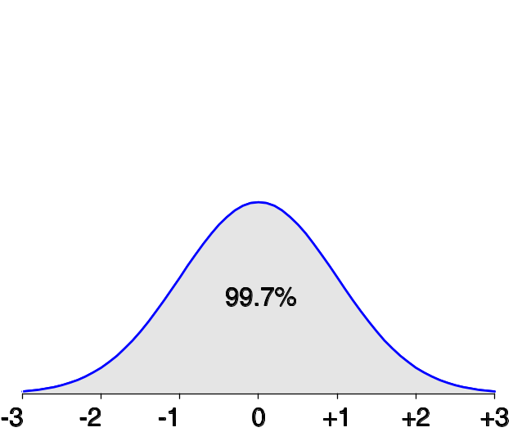
Measuring dispersion of data
The normal (distribution) curve
  From μ–σ to μ+σ: contains about 68% of the measurements (μ: mean, σ: standard deviation)
  From μ–2σ to μ+2σ: contains about 95% of it
  From μ–3σ to μ+3σ: contains about 99.7% of it

Slide 16

Boxplot Analysis
Five-number summary of a distribution:
  Minimum, Q1, M, Q3, Maximum
Boxplot
  Data is represented with a box
  The ends of the box are at the first and third quartiles, i.e., the height of the box is IRQ
  The median is marked by a line within the box
  Whiskers: two lines outside the box extend to Minimum and Maximum

Slide 17

Histogram Analysis
Graph displays of basic statistical class descriptions
  Frequency histograms
    A univariate graphical method
    Consists of a set of rectangles that reflect the counts or frequencies of the classes present in the given data

Slide 18
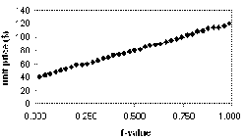
Quantile Plot
Displays all of the data (allowing the user to assess both the overall behavior and unusual occurrences)
Plots quantile information
  For a data xi data sorted in increasing order, fi indicates that approximately 100 fi% of the data are below or equal to the value xi

Slide 19
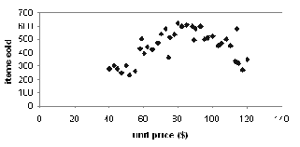
Scatter plot
Provides a first look at bivariate data to see clusters of points, outliers, etc
Each pair of values is treated as a pair of coordinates and plotted as points in the plane

Slide 20
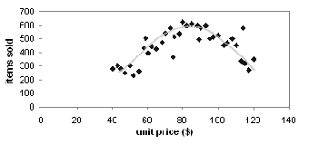
Loess Curve
Adds a smooth curve to a scatter plot in order to provide better perception of the pattern of dependence
Loess curve is fitted by setting two parameters: a smoothing parameter, and the degree of the polynomials that are fitted by the regression

Slide 21


Covarience
The covariance between two real-valued random variables X and Y,
with expected values
and is defined as
Understanding the correlation relationship

Slide 22
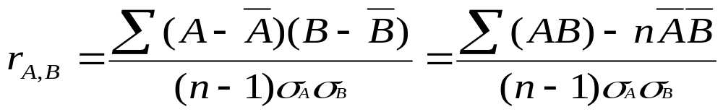


Correlation Analysis (Numerical Data)
Correlation coefficient (also called Pearson’s product moment coefficient)
  where n is the number of tuples, and are the respective means of A and B, σA and σB are the respective standard deviation of A and B, and Σ(AB) is the sum of the AB cross-product.
If rA,B > 0, A and B are positively correlated (A’s values increase as B’s). The higher, the stronger correlation.
rA,B = 0: independent; rA,B < 0: negatively correlated

Slide 23

Correlation Analysis (Categorical Data)
Χ2 (chi-square) test (we will return back again)
The larger the Χ2 value, the more likely the variables are related
The cells that contribute the most to the Χ2 value are those whose actual count is very different from the expected count

Slide 24
Dimensionality Reduction: Principal Component Analysis (PCA)
Given N data vectors from n-dimensions, find k ≤ n orthogonal vectors (principal components) that can be best used to represent data
Steps
  Normalize input data: Each attribute falls within the same range
  Compute k orthonormal (unit) vectors, i.e., principal components
  Each input data (vector) is a linear combination of the k principal component vectors
  The principal components are sorted in order of decreasing “significance” or strength
  Since the components are sorted, the size of the data can be reduced by eliminating the weak components, i.e., those with low variance. (i.e., using the strongest principal components, it is possible to reconstruct a good approximation of the original data
Works for numeric data only
Used when the number of dimensions is large

Slide 25
Principal Component Analysis
X2
Y1
Y2
X1

Slide 26
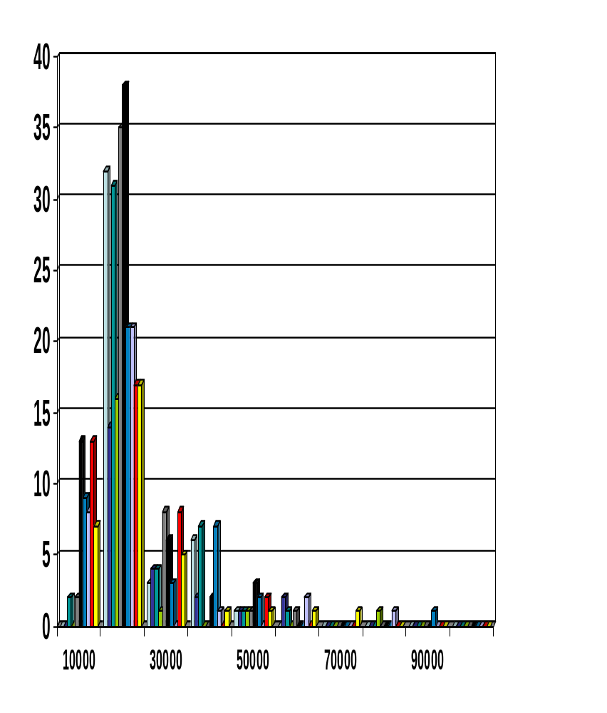
Data Reduction Method (2): Histograms
Divide data into buckets and store average (sum) for each bucket
Partitioning rules:
  Equal-width: equal bucket range
  Equal-frequency (or equal-depth)
Partition data set into clusters based on similarity, and store cluster representation (e.g., centroid and diameter) only

Slide 27
Sampling: Cluster or Stratified Sampling
Raw Data
Cluster/Stratified Sample

Slide 28
Discretization
Discretization:
  Divide the range of a continuous attribute into intervals
  Some classification algorithms only accept categorical attributes.
  Reduce data size by discretization
  Prepare for further analysis

Slide 29
Discretization and Concept Hierarchy
Discretization
  Reduce the number of values for a given continuous attribute by dividing the range of the attribute into intervals
  Interval labels can then be used to replace actual data values
  Supervised vs. unsupervised
  Split (top-down) vs. merge (bottom-up)
  Discretization can be performed recursively on an attribute
Concept hierarchy formation
  Recursively reduce the data by collecting and replacing low level concepts (such as numeric values for age) by higher level concepts (such as young, middle-aged, or senior)

Slide 30
Week 5-End
read
  Course Text Book Chapter 2
  Supplemantary Book “Machine Learning”- Tom Mitchell Chapter 5

